Slide 1
CSE-311/ CSE-312 Artificial intelligence

Slide 2
Slide 19: Feature Engineering

Slide 3
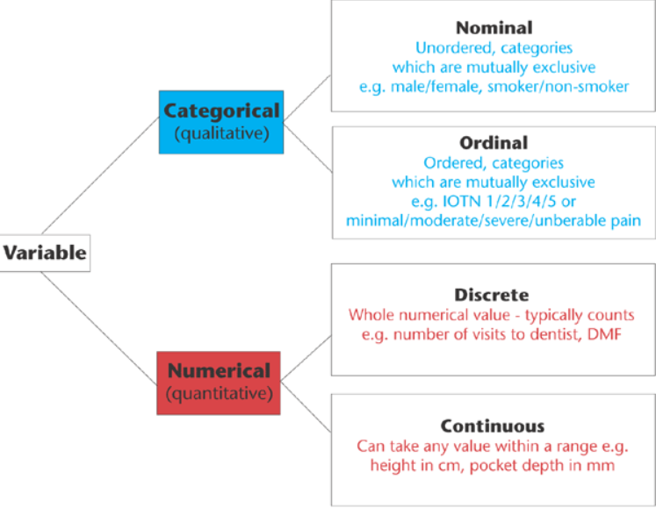

Slide 4
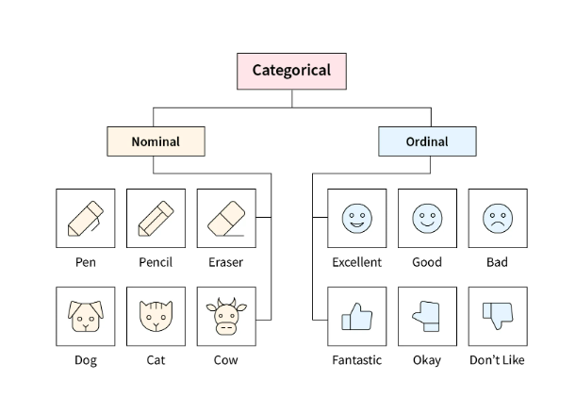

Slide 5
FEATURE ENGINEERING
WHAT IS FEATURE ENGINEERING?

Slide 6
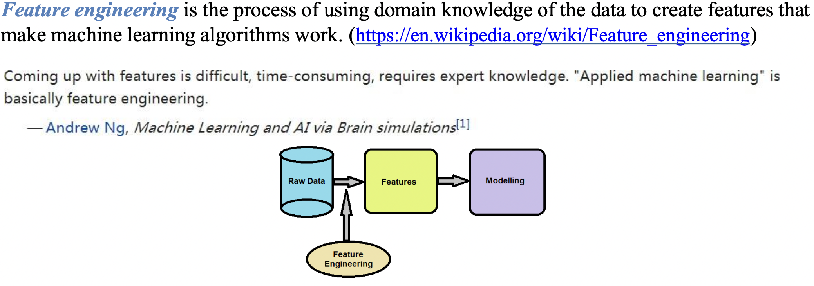

Slide 7
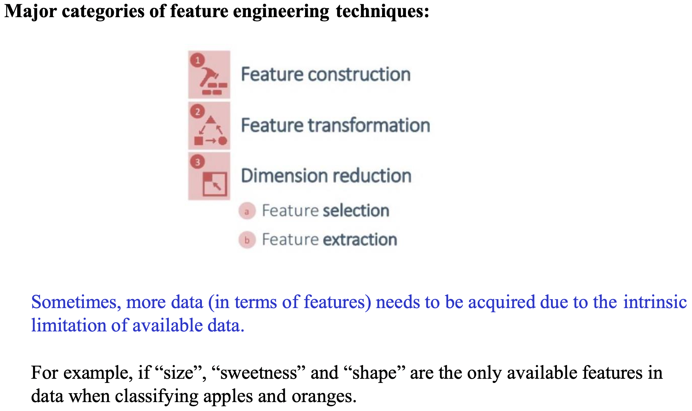

Slide 8
FEATURE ENGINEERING
FEATURE TRANSFORMATION

Slide 9
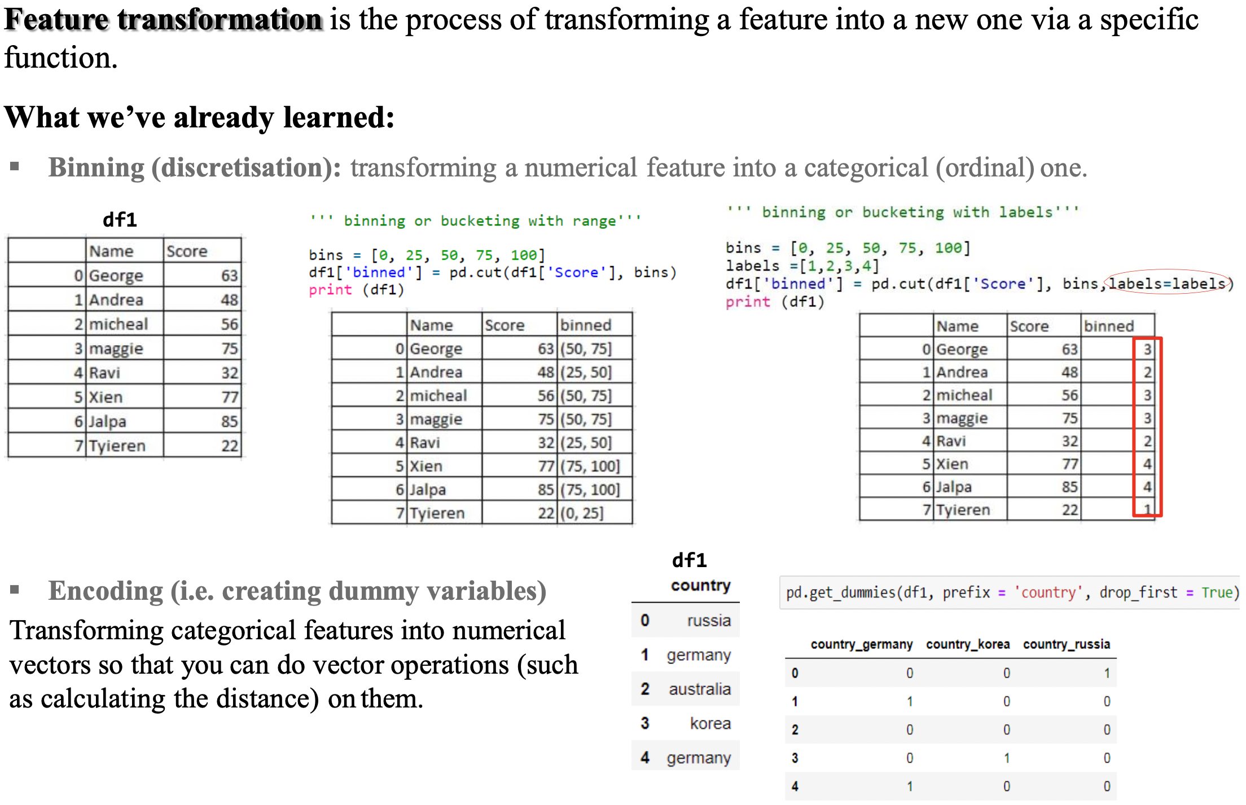

Slide 10
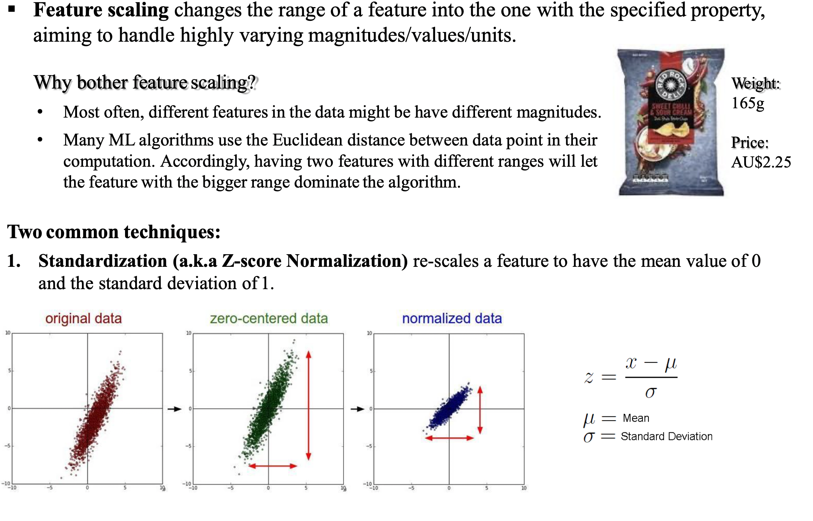

Slide 11
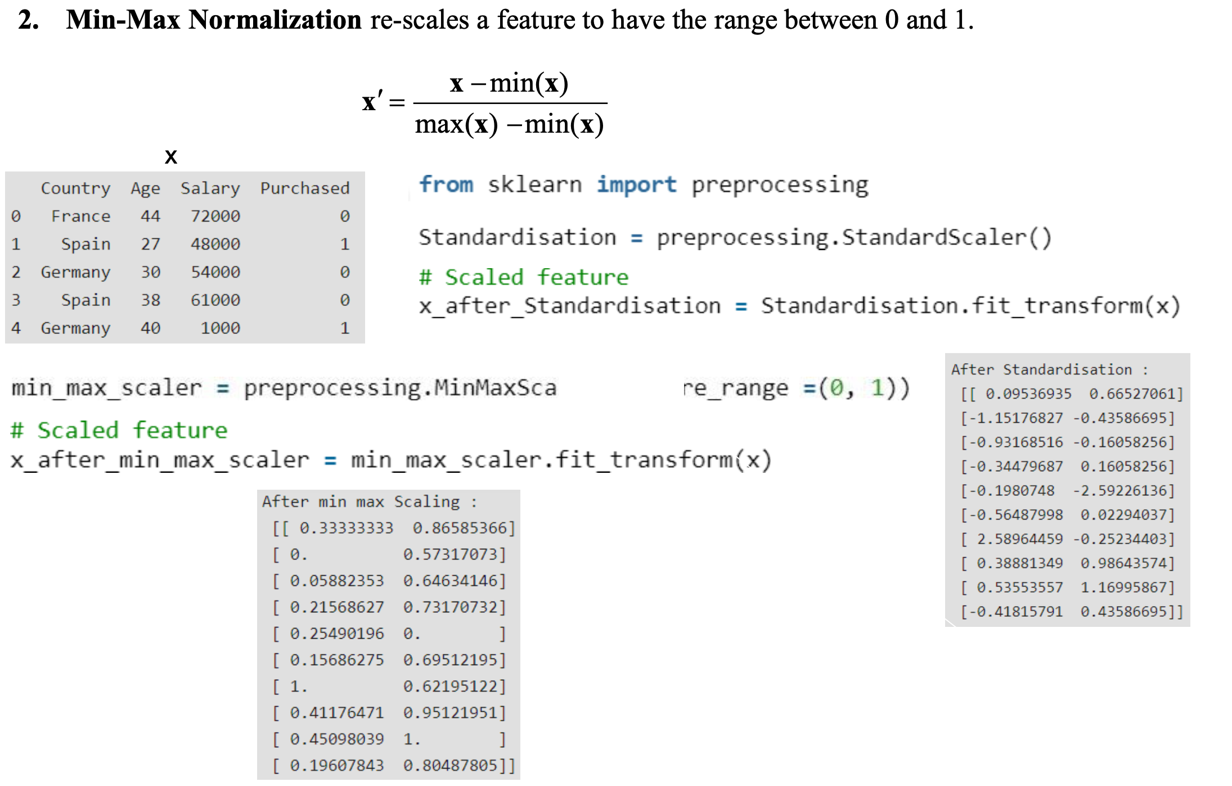

Slide 12
DIMENSION REDUCTION

Slide 13
Dimension = Feature

Slide 14
Dimension reduction
Curse of dimensionality refers to various phenomenon that arise when analyzing and organizing data in high dimensional spaces (often with hundreds or thousands of dimensions).
Dimension reduction is the process of reducing the number of features used to buld Machine Learning models with the purpose of keeping only relevant features. It is typically used to overcome the curse of dimensionality.
If we have more features than observations then we run the risk of massively overfitting our model.
When we have tii many features, observations become harder to cluster because large dimension causes every observation in the data set to appear equidistant from each other.

Slide 15
Dimension reduction
The main benefits are:
Faster computation
Less storage space required
Increased model performance
Can do Data Visualization (when reduced to 2D/3D)

Slide 16
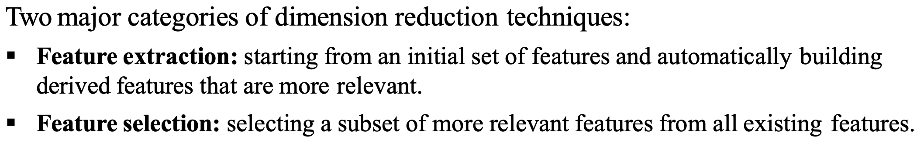

Slide 17
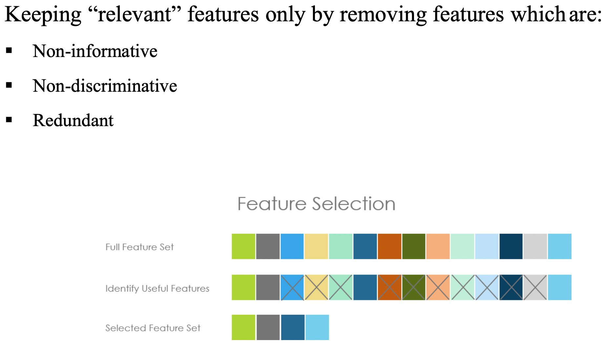

Slide 18
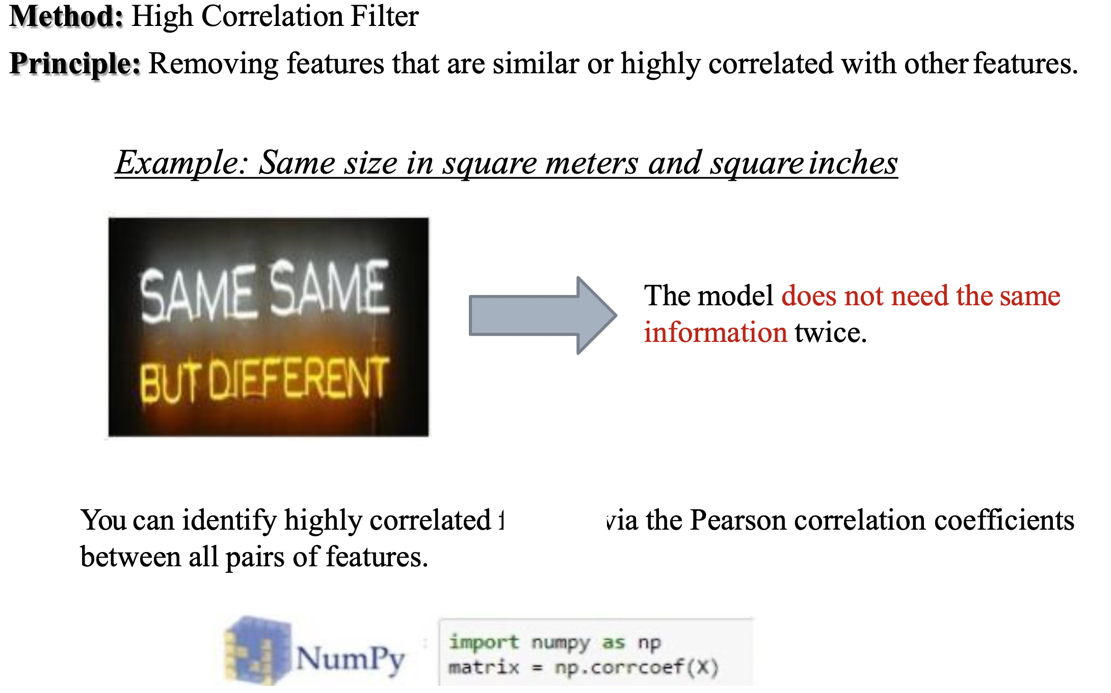

Slide 19
Question and Answers
Define feature engineering.
What is the difference between feature transformation and feature scaling?
What is dimension reduction and what are some of the major benefits of dimension reduction?
Explain, in details, what is feature selection and one method by which we apply it.

Slide 20
End of Slides

